Slide 1



ROBOTICS PROJECT
SMART BLIND CANE

Slide 2
TEAM MEMBERS -
NILOY SARKAR
ARIYAN RAHMAN MUGDHO
MOUTASIM FUAD IFTI

Slide 3


PROJECT OBJECTIVE
Enhance mobility and safety to visually impared individuals
Providing:
Obstacle Detection
Real-time location awareness
SOS Emergency System

Slide 4

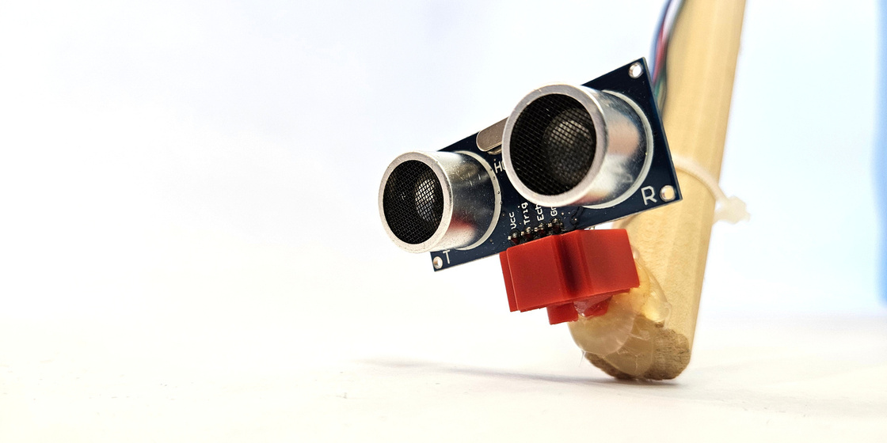


KEY FEATURES
Obstacle detection with directonal alert
GPS- based tracking system
SOS button to send emergency SMS with coordinates

Slide 5
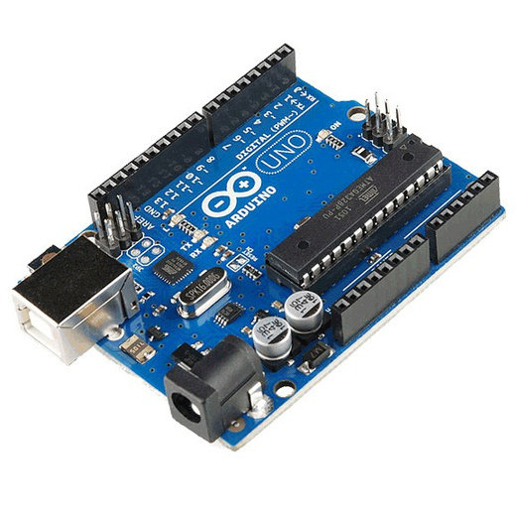
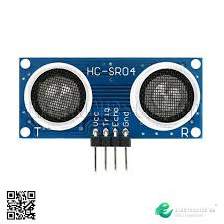

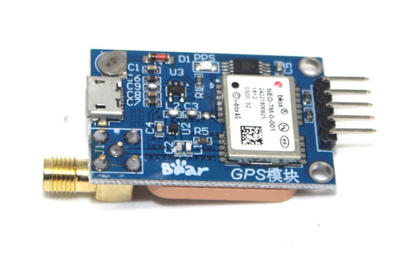
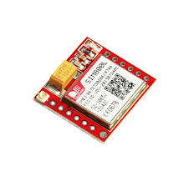
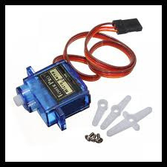
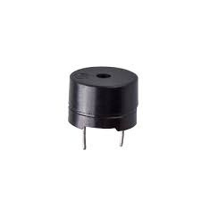
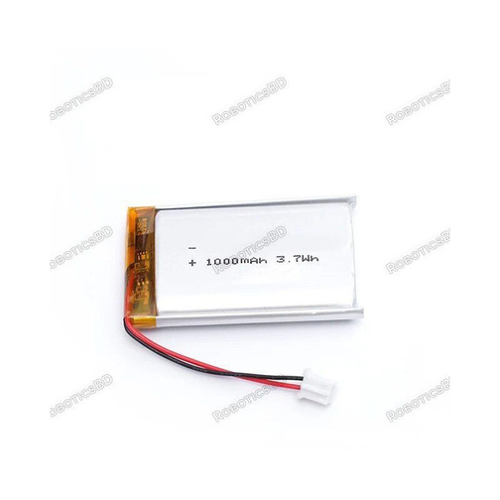
HARDWARE COMPONENTS
Arduino Uno R3
HC-SR04 Ultrasonic Sensor
NEO-7M GPS Module
SIM800L GSM Module
SG90 Servo Motor
DC Vibration Motor, Buzzer
Batteries, Breadboard, Blind Stick

Slide 6

OBSTACLE DETECTION FUNCTIONALITY
Servo rotates sensor 0°–180° continuously
Object within 30 cm triggers buzzer
Beep frequency changes by direction:
800 Hz = Left
1200 Hz = Right
Real-time auditory feedback for navigation

Slide 7

GPS TRACKING
5-second GPS data collection
Provides latitude & longitude
Displays clickable Google Maps URL
Works offline via satellite signals

Slide 8

SOS EMERGENCY ALERT
Pressing button triggers:
LED indicator
GPS coordinate retrieval
SMS to pre-configured contact
Sends text + Google Maps link
Works even in 2G network areas

Slide 9
CONCLUSION
Cost-effective assistive tech for the blind
Increases independence & safety
Scalable and upgradeable for future versions
Total cost: 3920 BDT – highly affordable

Slide 10
THANK YOU

